Slide 1

Visitor Pattern
Behavioral, Object focused

Slide 2
Motivation
Different types of cross object analysis and tracking requires a way for iterating through each entity.
While we can create iterators for each of this type of tasks, it would require additional structure and complexity, plus iterators will have to be specific to the task at hand
We need a way to visit each object and encapsulate the analysis on a separate object, so that any change in the task doesn’t require changing the objects themselves

Slide 3

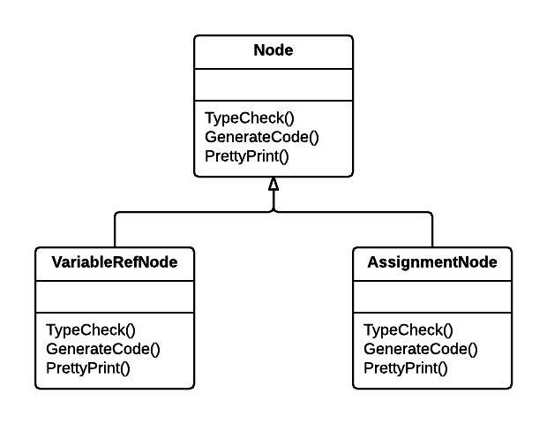
Example
Consider a compiler representing a program as an abstract syntax tree (AST)
The compiler must perform operations on the AST for “semantic” analysis
Type-checking
Code optimization
Pretty-printing
This requires a lot of nodes with a lot of operations
Maintaining this code base quickly becomes a nightmare

Slide 4
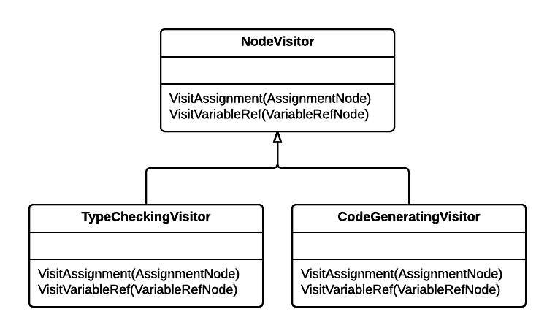
Example
It would be better if new operations could be added separately, and node classes were independent of the operations applied to them
This is obtained by packaging related operations in a separate class called Visitor
These Visitor objects are passed to elements of the AST as it is traversed

Slide 5
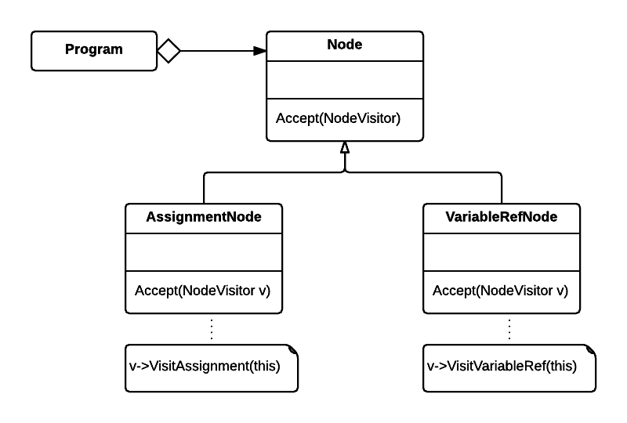
Solution

Slide 6
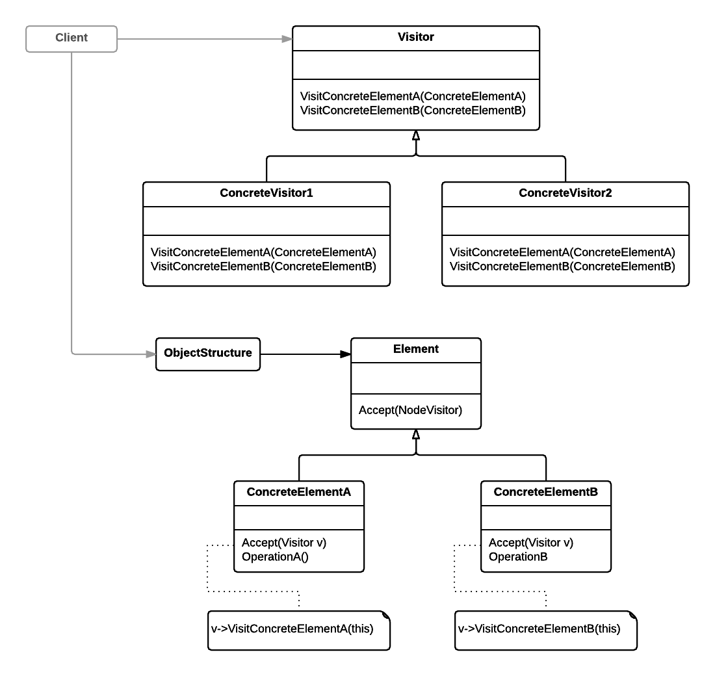
Structure
Visitor - Declares a Visit operation for each class of ConcreteElement in the object structure
ConcreteVisitor - Implements the Visitor interface along with the concrete logic
Element - Defines an Accept() operation with visitor as an argument
ConcreteElement - Implements the Accept() operation to allow a visitor
ObjectStructure -
Can enumerate its elements
Can be a composite or collection
May provide high level interface

Slide 7
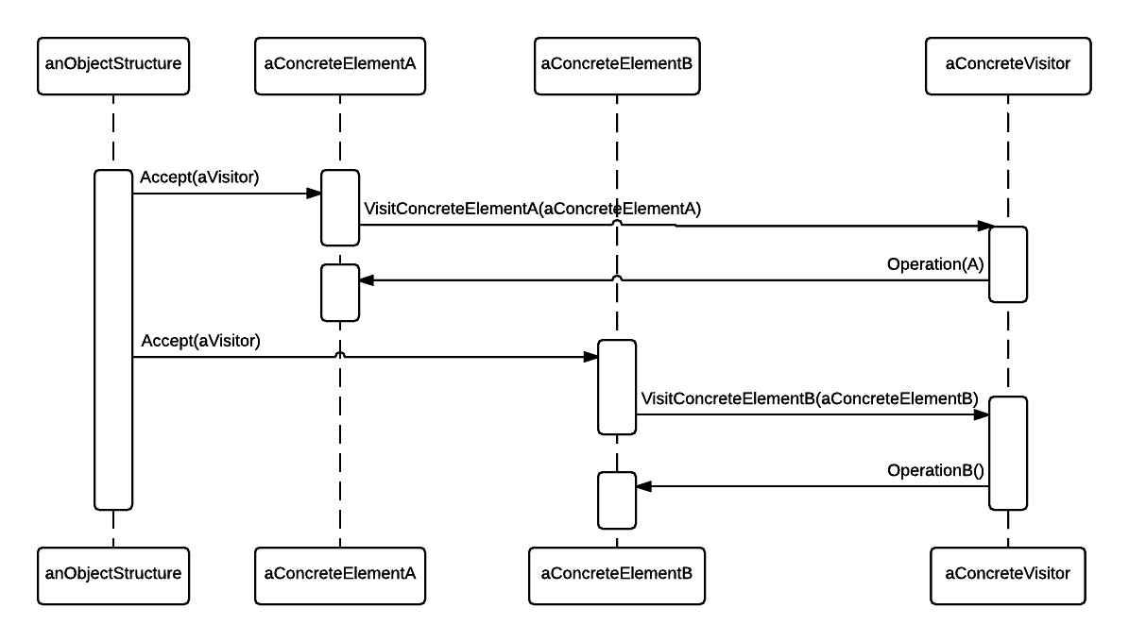
Sequence

Slide 8

Consequences
Pros:
Adding new operations is easy
Related operations are gathered together, unrelated operations are separated
Visitors can visit across different class hierarchies
Visitors can accumulate state while visiting each element
Cons:
Adding new ConcreteElement classes is difficult
Visitors assume the ConcreteElement interface lets them do their job, which typically breaks encapsulation

Slide 9
Example from “Design Patterns: Elements of Reusable Object-Oriented Software”
Erich Gamma
Richard Helm
Ralph Johnson
John Vlissides

Slide 10
Back to Lexi
Document structure: Composite Design Pattern
Formatting : Strategy Design Pattern
Embellishing the user interface: Decorator Pattern*
Supporting multiple look-and-feel standards: Abstract Factory Pattern
Supporting multiple window systems: Bridge Pattern*
User operations: Command Pattern*
Spelling checking and hyphenation: Visitor Pattern
* These patterns are not discussed in CS100

Slide 11
Problem
Lexi is almost done. We have finished all the internal structure, the visuals can be retargeted for several platforms, we have even incorporated user functions into it. The last step is to add a grammar and syntax checker, for it we must iterate through Glyphs and perform an analysis on them. Since Glyphs can’t analyze themselves (for example, spell checking happens at the word level) we need to encapsulate the iteration logic somehow.

Slide 12

Traversal vs. Traversal Actions
An iterator can provide a method of traversing the glyph structure BUT it does not provide a way to check spelling and do the hyphenation
Putting the responsibility for analysis in the Iterator makes analysis an integral part of traversal, which is not ideal
We want to distinguish between the traversal and the analysis being performed, this will increase reuse and extensibility
So, Where do we put the responsibility for analysis?

Slide 13

Requirements
The analyzer will have to distinguish between different kinds of glyphs
For example: Spelling and hyphenation only care about visible glyphs
Each analysis could add one or more abstract operations, and each subclass would have to implement them with the role they play
We need to encapsulate the analysis into a separate set of classes that are not part of the iterator itself

Slide 14

Encapsulating the Analysis
The analysis object can interact with the appropriate iterator to perform its analysis
The iterator object “carries” the analysis object to each glyph in the document structure
The analysis object can visit this glyph and perform a piece of the analysis
The analysis object performs a piece of the analysis at every step of the traversal, accumulating the entire analysis

Slide 15


In other words
The iterator will function as a guide that provides access to each of the target glyphs
The analyzer follows the iterator through each glyph doing the analysis
Imagine a hotel that is being audited by the health department. Someone in the hotel (the iterator) will open every room for the inspector using the room’s interface. The inspector goes into the room and does his analysis of the room.

Slide 16
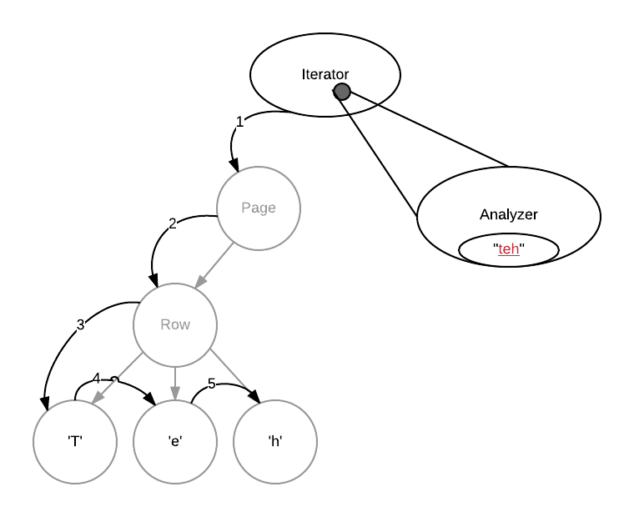
Spell Check Example

Slide 17
Ugly code
void SpellingChecker::Check (Glyph* glyph) {
Character* c;
Row* r;
Image* i;
if (c = dynamic_cast<Character*>(glyph)) {
// analyze the character
} else if (r = dynamic_cast<Row*>(glyph)) {
// prepare to analyze r's children
} else if (i = dynamic_cast<Image*>(glyph)) {
// do nothing
}
}
If/Else trees are ugly, prone to generate bugs and will need an overhaul if change the Glyph hierarchy
Type checking is not effective, hard to extend and may cause problems.

Slide 18
How do we do this?
Consider the following abstract operation added to the Glyph class: void CheckMe(SpellingChecker&)
Every Glyph subclass would define CheckMe void GlyphSubclass::CheckMe(SpellingChecker& checker) { checker.CheckGlyphSubclass(this); }
Here GlyphSubclass would be replaced by the name of each glyph subclass
When CheckMe is called, the specific subclass is now known

Slide 19
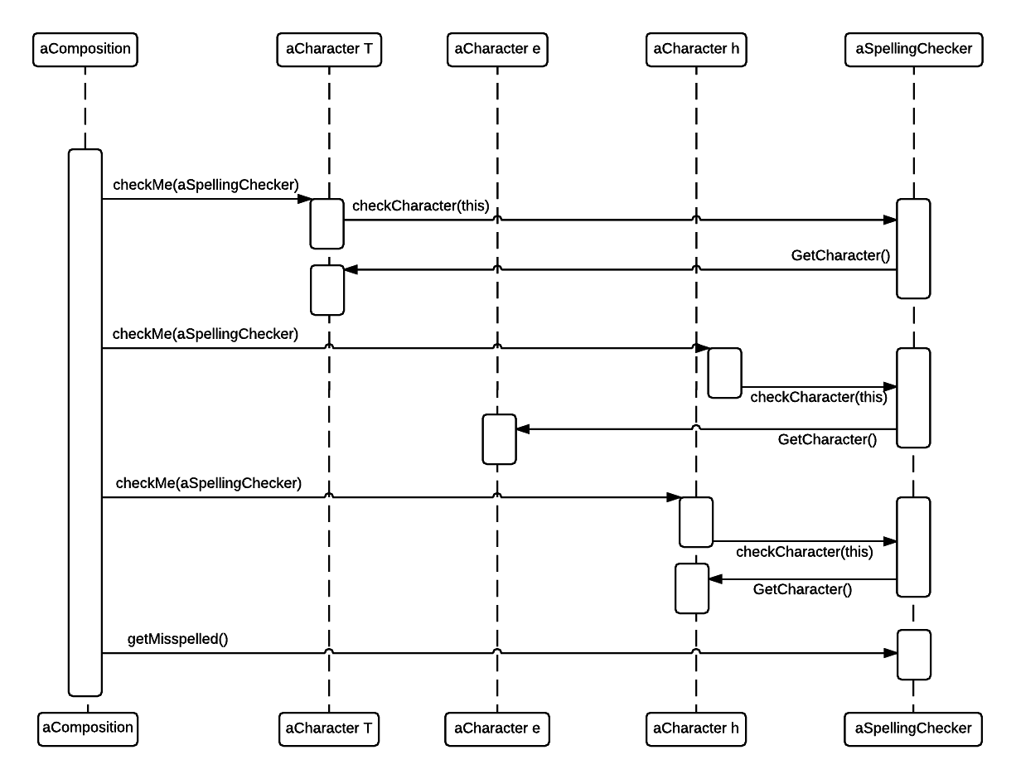

Slide 20
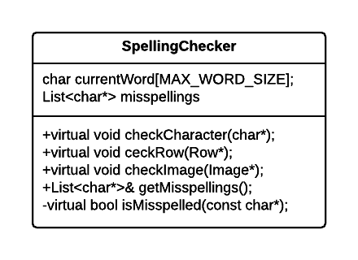
SpellingChecker class
Void SpellingChecker::checkCharacter(char* c) {
if(isalpha(c)) {
//append to this->currentWord
} else {
// We hit a non-alphabetic character
if (isMisspelled(this->currentWord) {
// add to this->misspellings
}
// Reset the current word
this->currentWord[0] = ‘\0’;
}
}

Slide 21
Running it
We traverse the glyph structure calling checkMe on each glyph with the SpellingChecker as an argument
SpellingChecker* spellCheck; Composition* c; // … PreorderIterator iter(c); for (iter.First(); !iter.is_done(); iter.Next()) { Glyph* g = iter.Current(); g->checkMe(spellCheck); }

Slide 22

Supporting Multiple Analyses
If we want to support other kinds of analysis, we must build a different visitor from scrath
Instead, we will use a more generic visitor pattern
The visitor interface accept(Visitor*) replaces the analysis-dependent operations like checkMe(SpellingChecker&)
Specific visitor functions like checkCharacter(char*) are replaced by functions relating to a specific class visitCharacter(Character*)
This becomes the abstract Visitor class and each analysis will be implemented as a concrete Visitor

Slide 23
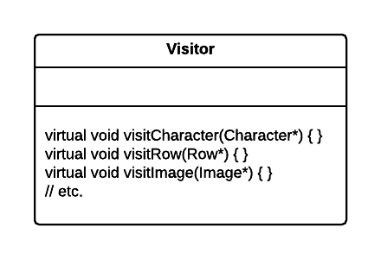
Visitor Class
class Visitor {
public:
virtual void visitCharacter(Character*) { }
virtual void visitRow(Row*) { }
virtual void visitImage(Image*) { }
// Visit functions for all Glyph classes
};

Slide 24
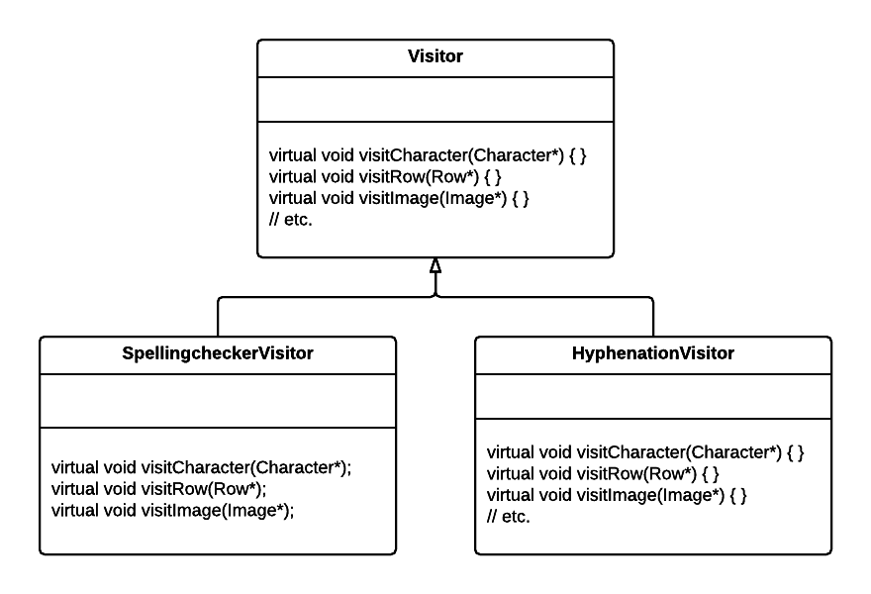
Visitor Class and Concrete Subclasses
SpellingCheckerVisitor is implemented the same way as before except checkCharacter is replaced with visitCharacter, etc.

Slide 25
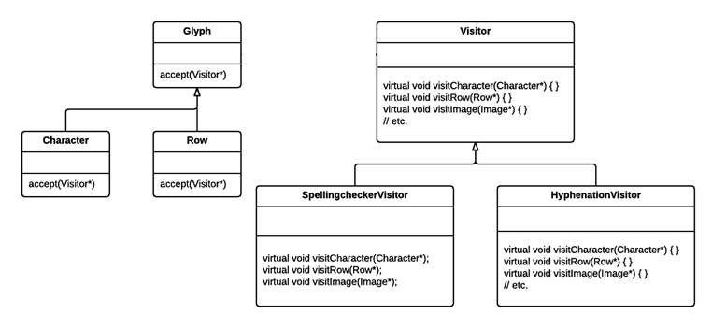
Visitor Class and Concrete Subclasses

Slide 26
How would we design a hyphenation class as a visitor subclass?

Slide 27
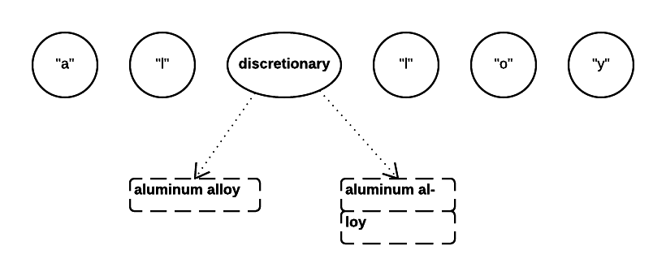
HyphenationVisitor
Traverse the text to accumulate characters into words
Once an entire word has been assembled, apply an algorithm to determine potential hyphenation points
At each hyphenation point, insert a discretionary glyph into the composition
A discretionary glyph has two possible appearances, depending on whether or not it is the last character on a line, a hyphen or no appearance

Slide 28
Visitor Pattern Review
The Visitor class and its subclasses allows an open-ended number of analyses on glyph structures without having to edit the glyph classes themselves
Visitors can be applied to any object structure, not just composite structures
The object structure should have a traversal object (iterator)
The visitor pattern is most suitable when you want to be able to do a variety of different things to objects with a stable class structure
Adding a new kind of visitor requires no change to that class structure
Adding a subclass to the structure requires an update to all visitor interfaces to include a Visit operation for that subclass

